Slide 1
Document Object Model

Slide 2
What are me going to look at?
What is DOM and why do we need it?
What does a DOM looks like?
How is it made?
How it is used?
DOM in modern frameworks
Modern DOM tools
jQuery vs Modern Approach
Best Practices

Slide 3

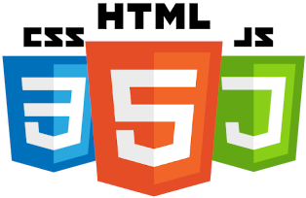

Why is DOM required?
HTML was designed simply to structure and display documents.
There was no way for a programming language to interact with page.
If you wanted to change you had to request a brand new HTML page from the server.
This was slow and limited the user experience.
The DOM solved this problem by creating a live, programmable model of the HTML document in the browser's memory. It represents the page as a logical tree of objects
Wait, can only JS can do DOM manipulation?
No but all the DOM manipulations are either done by JS or though JS

Slide 4
Why is DOM required?
HTML was designed simply to structure and display documents.
There was no way for a programming language to interact with page.
If you wanted to change you had to request a brand new HTML page from the server.
This was slow and limited the user experience.
The DOM solved this problem by creating a live, programmable model of the HTML document in the browser's memory. It represents the page as a logical tree of objects
Wait, can only JS can do DOM manipulation?
No but all the DOM manipulations are either done by JS or though JS

Slide 5
Why is DOM required?
HTML was designed simply to structure and display documents.
There was no way for a programming language to interact with page.
If you wanted to change you had to request a brand new HTML page from the server.
This was slow and limited the user experience.
The DOM solved this problem by creating a live, programmable model of the HTML document in the browser's memory. It represents the page as a logical tree of objects
Wait, can only JS can do DOM manipulation?
No but all the DOM manipulations are either done by JS or though JS

Slide 6
What is DOM?
a programming interface, or an API, that represents the structure of an HTML or XML document as a tree of objects, allowing scripts and programs to dynamically access, update, and manipulate the content, structure, and style of the document
Key Points:
DOM is NOT the source HTML - it's a live representation
Browser creates DOM when loading a page
JavaScript can read and modify the DOM
Changes to DOM immediately reflect in the browser

Slide 7
What is DOM?
a programming interface, or an API, that represents the structure of an HTML or XML document as a tree of objects, allowing scripts and programs to dynamically access, update, and manipulate the content, structure, and style of the document
Key Points:
DOM is NOT the source HTML - it's a live representation
Browser creates DOM when loading a page
JavaScript can read and modify the DOM
Changes to DOM immediately reflect in the browser

Slide 8
What does a DOM looks like?
<!DOCTYPE html>
<html>
<head>
<title>MyPage</title>
<meta name="description" content="this is a example site" />
</head>
<body>
<header>
<h1>Heading</h1>
</header>
<main>
<p>paragraph</p>
<div>
<span>some text</span>
<button>click me</button>
</div>
</main>
<footer>Footer</footer>
</body>
</html>
Document
└── html
├── head
│ ├── title
│ └── meta
└── body
├── header
│ └── h1
├── main
│ ├── p
│ └── div
│ ├── span
│ └── button
└── footer
Dom is a Tree like structure of the page which helps the programming language parse it
Tree Characteristics:
Each HTML element becomes a node
Hierarchical parent-child relationships
Text content also becomes nodes
Attributes are properties of element nodes

Slide 9
What does a DOM looks like?
<!DOCTYPE html>
<html>
<head>
<title>MyPage</title>
<meta name="description" content="this is a example site" />
</head>
<body>
<header>
<h1>Heading</h1>
</header>
<main>
<p>paragraph</p>
<div>
<span>some text</span>
<button>click me</button>
</div>
</main>
<footer>Footer</footer>
</body>
</html>
Document
└── html
├── head
│ ├── title
│ └── meta
└── body
├── header
│ └── h1
├── main
│ ├── p
│ └── div
│ ├── span
│ └── button
└── footer
Dom is a Tree like structure of the page which helps the programming language parse it
Tree Characteristics:
Each HTML element becomes a node
Hierarchical parent-child relationships
Text content also becomes nodes
Attributes are properties of element nodes

Slide 10
What does a DOM looks like?
<!DOCTYPE html>
<html>
<head>
<title>MyPage</title>
<meta name="description" content="this is a example site" />
</head>
<body>
<header>
<h1>Heading</h1>
</header>
<main>
<p>paragraph</p>
<div>
<span>some text</span>
<button>click me</button>
</div>
</main>
<footer>Footer</footer>
</body>
</html>
Dom is a Tree like structure of the page which helps the programming language parse it
Tree Characteristics:
Each HTML element becomes a node
Hierarchical parent-child relationships
Text content also becomes nodes
Attributes are properties of element nodes
Document
└── html
├── head
│ ├── title
│ └── meta
└── body
├── header
│ └── h1
├── main
│ ├── p
│ └── div
│ ├── span
│ └── button
└── footer

Slide 11
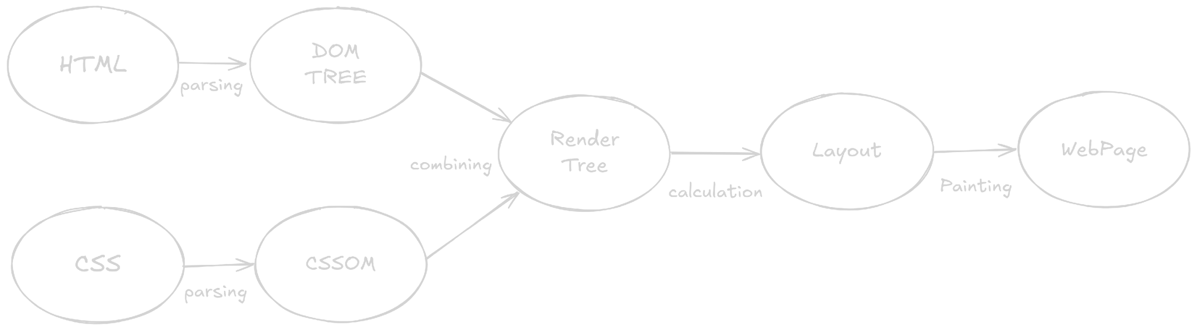
How is it made?
Steps
The browser reads the raw HTML file (e.g., index.html).
It converts the characters into tokens (like <html>, <head>, <body>).
These tokens are transformed into nodes.
Finally, these nodes are linked together in a parent-child tree structure called the DOM Tree.
Types of Nodes
1. Element Nodes
HTML tags: <div>, <p>, <span>
  Most common type for manipulation
2. Text Nodes
Text content inside elements
Whitespace also creates text nodes
3. Attribute Nodes
Element attributes: id, class, src
Accessed as properties, not separate nodes in modern DOM
4. Other Node Types:
Comment nodes
Document fragments

Slide 12
How is it made?
Steps
The browser reads the raw HTML file (e.g., index.html).
It converts the characters into tokens (like <html>, <head>, <body>).
These tokens are transformed into nodes.
Finally, these nodes are linked together in a parent-child tree structure called the DOM Tree.
Types of Nodes
1. Element Nodes
HTML tags: <div>, <p>, <span>
  Most common type for manipulation
2. Text Nodes
Text content inside elements
Whitespace also creates text nodes
3. Attribute Nodes
Element attributes: id, class, src
Accessed as properties, not separate nodes in modern DOM
4. Other Node Types:
Comment nodes
Document fragments

Slide 13
Steps
The browser reads the raw HTML file (e.g., index.html).
It converts the characters into tokens (like <html>, <head>, <body>).
These tokens are transformed into nodes.
Finally, these nodes are linked together in a parent-child tree structure called the DOM Tree.
How is it made?
Types of Nodes
1. Element Nodes
HTML tags: <div>, <p>, <span>
  Most common type for manipulation
2. Text Nodes
Text content inside elements
Whitespace also creates text nodes
3. Attribute Nodes
Element attributes: id, class, src
Accessed as properties, not separate nodes in modern DOM
4. Other Node Types:
Comment nodes
Document fragments

Slide 14
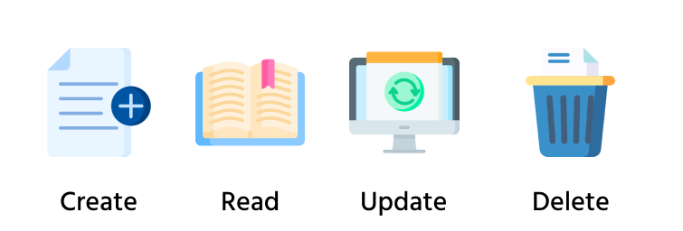
How it is used?
You can think of interacting with the DOM like managing data in a database.

Slide 15
How it is used?
Create: Adding New Elements
This involves creating a brand-new element from scratch and placing it on the page.
Steps:
Create the element:
  Use document.createElement('tagName’).
    This creates an element in memory, but it's not yet on the page.
Add content/attributes:
  Set properties like .textContent, .className, or .id.
Append to the DOM:
  Find a parent element on the page and use .append() or .appendChild() to attach your new element.
const userList = document.querySelector('#user-list');
const newListItem = document.createElement('li');
newListItem.textContent = 'Charlie';
newListItem.className = 'user';
userList.append(newListItem);

Slide 16
How it is used?
Create: Adding New Elements
This involves creating a brand-new element from scratch and placing it on the page.
Steps:
Create the element:
  Use document.createElement('tagName’).
    This creates an element in memory, but it's not yet on the page.
Add content/attributes:
  Set properties like .textContent, .className, or .id.
Append to the DOM:
  Find a parent element on the page and use .append() or .appendChild() to attach your new element.
const userList = document.querySelector('#user-list');
const newListItem = document.createElement('li');
newListItem.textContent = 'Charlie';
newListItem.className = 'user';
userList.append(newListItem);

Slide 17
How it is used?
But how did we select the parent?
Answer : selectors
What are these selectors?
Answer : selectors are methods used in JavaScript to access and manipulate HTML elements within a web page

Slide 18
How it is used?
2. Selectors
  document.getElementById()
    let myElement = document.getElementById('myUniqueId’);
  document.getElementsByClassName()
    let elementsByClass = document.getElementsByClassName('myClass’);
  document.getElementsByTagName()
    let paragraphs = document.getElementsByTagName('p’);
  document.querySelector()
    let firstDiv = document.querySelector('div.container’);
  document.querySelectorAll()
    let allButtons = document.querySelectorAll('button.action-btn');

Slide 19
How it is used?
2. Some more Selectors
element.parentNode
element.children
element.childNodes
element.firstChild
element.lastChild
element.firstElementChild
element.lastElementChild
element.nextSibling
element.previousSibling
element.nextElementSibling
element.previousElementSibling

Slide 20
How it is used?
Updation
  Content:
    Change the text with .textContent or the inner HTML with .innerHTML.
  Styling:
    Modify CSS directly with the .style property (e.g., element.style.color = 'blue’).
  Attributes:
    Change attributes like class or src using .className or .setAttribute().

Slide 21
How it is used?
3. Deletion
element.remove():
The modern and simplest way to delete a node from the DOM.
element.removeChild();
To remove a specified child node from its parent node

Slide 22
How it is used?
4. Event Listeners
An event listener is a JavaScript function that waits for a specific event to happen on a target element and then runs a block of code in response.
Syntax:
targetElement.addEventListener('eventName', functionToRun);
Events
'click': The user clicks the element.
'mouseover': The user's mouse pointer moves over the element.
'mouseout': The mouse pointer moves off the element.
'keydown': The user presses a key on the keyboard.
'submit': A form is submitted.

Slide 23
4. Event Listeners
An event listener is a JavaScript function that waits for a specific event to happen on a target element and then runs a block of code in response.
Syntax:
targetElement.addEventListener('eventName', functionToRun);
How it is used?
Events
'click': The user clicks the element.
'mouseover': The user's mouse pointer moves over the element.
'mouseout': The mouse pointer moves off the element.
'keydown': The user presses a key on the keyboard.
'submit': A form is submitted.

Slide 24
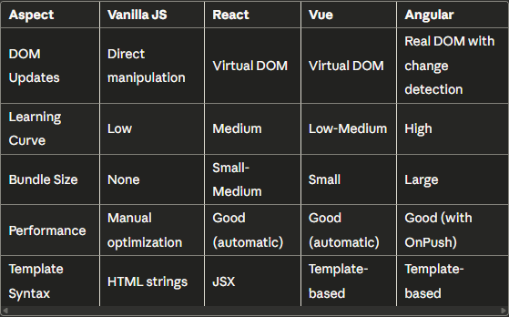
DOM in modern frameworks

Slide 25
Modern DOM tools
Web Components
  Custom components without any library
Shadow DOM
  A scoped DOM subtree attached to an element
  Why? Provides true encapsulation for markup, styles, and behavior.
Intersection Observer API
  Lets you watch when an element enters or leaves the viewport (or a parent container).
  Why? Avoids expensive scroll event listeners with manual getBoundingClientRect()

Slide 26
Modern DOM tools
Mutation Observer API
  Listens for changes in the DOM tree (child add/remove, attribute change, text change).
  Why: Replaces inefficient DOM polling (setInterval checks).
Modern CSS (CSS Grid, Flexbox) reducing need for JS manipulation

Slide 27
jQuery vs Modern Approach

Slide 28
Best Practices
Minimize DOM Queries
  Less DOM element access count
Use Document Fragments for Multiple Insertions
  Intermediate fragment usage
Event Delegation for Dynamic Content
  Event listener on parent instead of every child
Avoid Layout Thrashing
  Changes in less steps
Debounce Expensive Operations
  Avoid heavy task on little change
Memory Management
  Clean-up functions

Slide 29
Thank You

